Slide 1

Let's Take A Closer Look At...
Let's Take A Closer Look At...

Slide 2


Let's Take A Closer Look At...
Let's Take A Closer Look At...
Your Thinking Into Results Consultants
Facilitators
Mentors

Slide 3
A step by step course that will show you exactly how to get what you want!
WHY ARE YOU HERE?
WHY ARE WE HERE?
Share information so you can make a major change.
Introduce you to a roadmap to success for every part of your life.
Invite you to talk with us on how Bob Proctor’s mentoring system can help you.

Slide 4


Slide 5
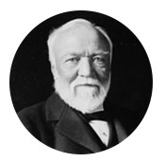
The Legacy Started Here
AndreCarnagie, the first billionaire Challenged Napolean Hill to interview the
world’s most successful people in order to create a simple formula that anyone
can follow in order to achieve success and become wealthy.

Slide 6
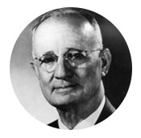
Napoleon Hill
accepted the challenge and in 1937 published the original version of “Think and Grow Rich.”

Slide 7
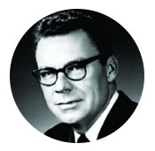
Earl Nightingale, In 1960 co-founded the Nightingale-Conant Corporation. The company produced personal development material recorded on vinyl records. Earl Nightingale studied “Think and Grow Rich” and ultimately won a Literary Prize from Hill’s Foundation in 1989.

Slide 8
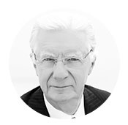
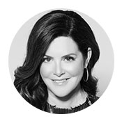
In 1961, Bob Proctor started studying “Think and Grow Rich” and it transformed his life in addition to studying the book. Bob listened to Earl Nightingale’s condensed recording of the book thousands of time. Then, Bob worked shoulder-to-shoulder with Earl Nightingale at Nightingale-Conant from 1968 to 1973, before leaving to start his own personal development company. Today, Bob has studied thousands of books, continues to read “Think and Grow Rich” every day, and is considered the world’s foremost expert on the human mind.
In 2006, a very successful attorney named Sandy Gallagher attended one of Bob Proctor’s three-day seminars. Those three days transformed her life and eventually she joined forces with Bob to create the Proctor Gallagher Institute.

Slide 9
Do The Following Define You?
“I just can’t get my team on the same page.”
“I want more out of life, but don’t know what to do.”
“I have goals, but they seem so far away.”
“I have a lot of good ideas, but never follow through with them.”
“I feel like I was meant for more, I was meant to do great things.”
“I’m stuck.”
“I don’t even know what I want; I just know I want more.”
“I struggle to stay focused and constantly procrastinate.”
“I struggle with money” and always broke.”
“I don’t have balance in my life.”

Slide 10
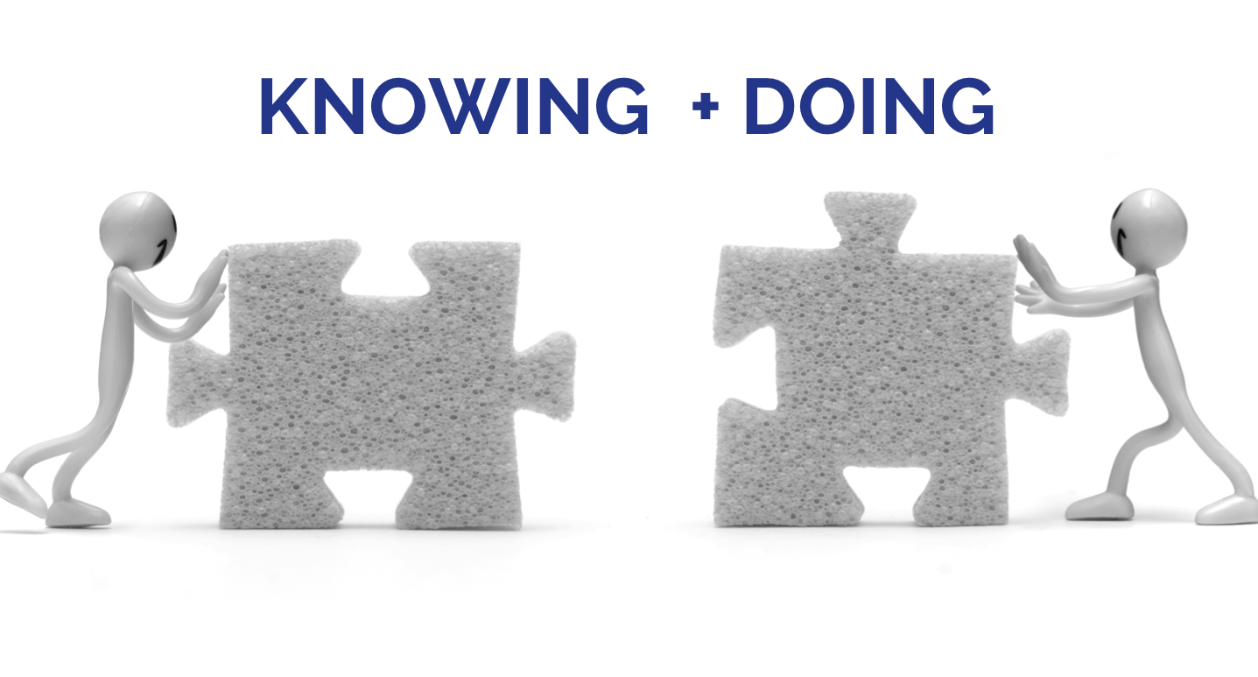
Knowing-Doing Gap

Slide 11

Let's Take A Closer Look At...
And How They Happen

Slide 12
?
DO RESULTS
JUST
HAPPEN
HOW DO
RESULTS
HAPPEN

Slide 13
2.
WHERE
YOUARE GOING
GOALS
1.
WHERE
Why are so many
people stuck?
It's so simple,
and so obvious,
Paradigms
YOU ARE
2 Things You Must Know To Improve Your Results.

Slide 14
paradigm
…is a mental program that has almost exclusive control over our habitual behavior… AND
almost all of our behavior is habitual.

Slide 15

?
OTHER
PEOPLE’S
HABITS
WHAT ARE
PARADIGMS
PARADIGMS
Are A Multitude Of Habits
Passed on from one generation to the next!

Slide 16

AWARENESS

Slide 17
A person doesn’t earn $100,000 a year because they want to earn $100,000 a year.
They earn $100,000 a year because they are not Aware of how to earn $100,000 a month !
It is a sad thing when you see a CHILD who is afraid of
The DARK
?
You eliminate DARKNESS
When you turn on the LIGHT
Let this YELLOW DOT represent your Level Of AWARENESS
How do I Expand My Level Of Awareness
Your Ability
To Enjoy The Good Life Is
Dependent On Your
Level Of Awareness
AWARENESS
Effective Education ... combined with Mentoring; over a reasonable period of time, will Expand A Person’s Level Of Awareness and Improve The Quality Of Their Life.
…but it is even worse, is when you see an ADULT afraid of
The LIGHT
Everything You Are Seeking Is Seeking You!
Notes:
17

Slide 18
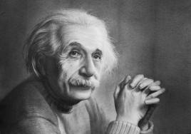
“Everything is energy and that’s all there is to it. Match the frequency of the reality you want, and you cannot help but get that reality. It can be no other way.
This is not philosophy this is physics.”
Albert Einstein

Slide 19
Most people think they think but they…
DON’T!

Slide 20
It’s All About The….
MIND

Slide 21
Your Marvelous….
MIND

Slide 22

YOU
Are A Mass
Of Energy
And You
Function On
Frequencies

Slide 23
In 1934 Dr. Thurman Fleet was very involved
in the Healing Arts and Holistic Health.
Let's Look At The
Conscious
Mind
MIND
Sub-
YOUR MIND
He stated, "The Mind is an activity
not a thing. No one has ever seen
the Mind. In order to gain clarity
and eliminate confusion, I will
create a image we can work with."
Conscious
Mind
And YOUR Paradigm
And Paradigms
Body
"This is the most valuable idea I have ever learned."
Bob Proctor

Slide 24
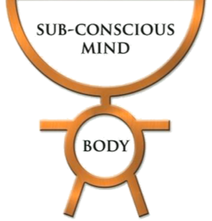
WE’VE BEEN PROGRAMMED
INFORMATION
IDEAS
RULES
VALUES
BELIEFS
Paradigm

Slide 25

School gave us
valuable knowledge
However SCHOOL never taught us how to alter our old PARADIGMS
Therefore we frequently do not do, what we Already Know how to do!
PARADIGM
NEW PARADIGM
Superior Knowledge
Inferior Results
Results
Results
Causes Confusion & Frustration
Notes:
25

Slide 26
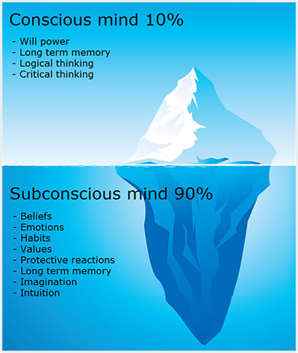
Let’s Talk About the Mind

Slide 27

“To be able to shape your future, you have to be WILLING and ABLE to
CHANGE YOUR PARADIGM”
AUTHOR OF “PARADIGMS”
JOEL BARKER

Slide 28
Weakness of
YOU
ARE ONLY
LIMITED BY...
ATTENTION
and
Poverty of
IMAGINATION

Slide 29
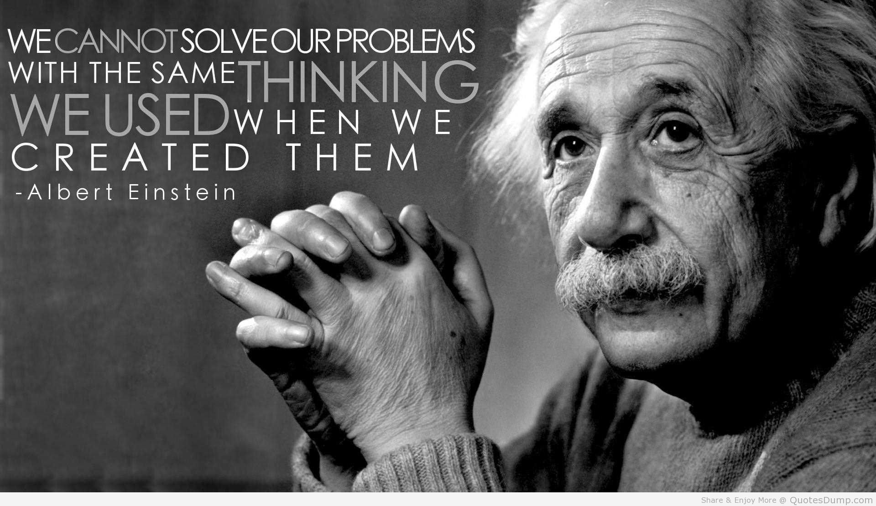

Slide 30

What do we mean when we talk about RESULTS?

Slide 31
Financial - If you are not able to afford the things you desire in life, then you have to ask yourself
why?
Business – Not meeting sales targets
Relationships – unhappy, not enough balance
Health – eating healthy, losing weight, gaining weight
Career – not moving in the direction you want

Slide 32
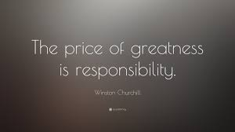
This all stems back to you.
Take responsibility
You are responsible for the results you are getting.

Slide 33
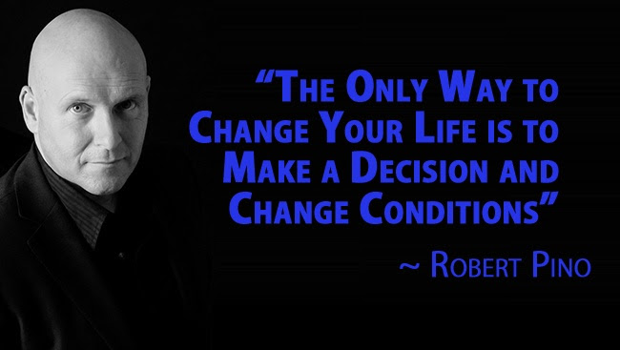

Slide 34
Are you in control or is the situation in control of you?

Slide 35
Circumstance
You have to focus and control the circumstance so that
it is not controlling you.

Slide 36
“People are always blaming their circumstances for what they are. I don’t believe in circumstances. The people who get on in this world are the people who get up and look for the circumstances they want, and, if that can’t find them, they make them”
~ George Bernard Shaw

Slide 37
Self Image
The results you are achieving are a direct reflection of the image you are holding of your self

Slide 38

What do you really want?

Slide 39
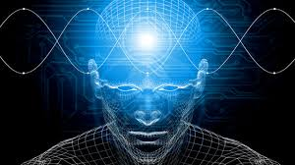
To change your results you have to understand the mind.

Slide 40

Individual
Family
Young Professionals
College Students
Business Owners
Health Professionals
Entrepreneurs
Educators/Home School
Businesses Large / Small
Sales / Managers
High School Students
Athletes
Pastors
Leaders/Executives
How About You?

Slide 41
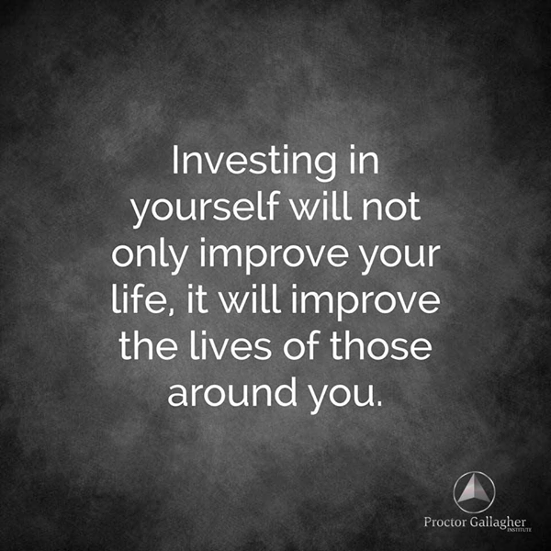

Slide 42

What’s Next?

Slide 43
Final Questions
What do you really want?
How am I living my life?
How Do I Want to live my life?
If not now?
When?

Slide 44

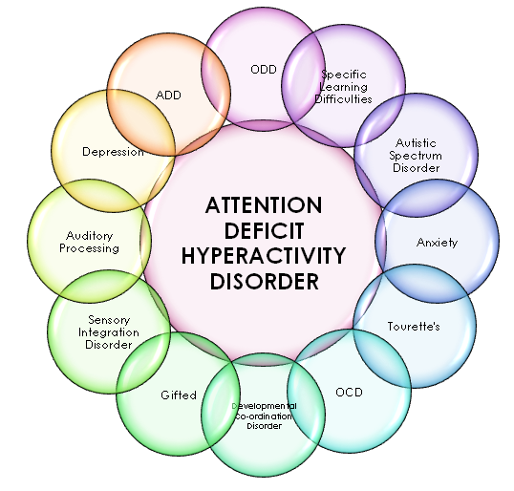
The Damion Story
This is the Power of Thinking Into Results

Slide 45

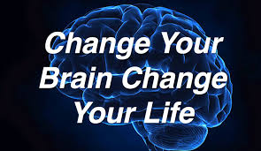
Change Your Brain Change Your Life
Daniel Amen, MD

Slide 46

4 Pillars
Power of Focus
Deepen Self-Awareness
Sound Understanding
Action/Results

Slide 47

YOU HAVE TO CHANGE THE WAY YOU THINK
IF YOU WANT DIFFERENT RESULTS

Slide 48
Who is This For?
How About You?

Slide 49
Your Next Step
Free Strategy Session
Explore Which Program Is Right for You
Thinking Into Results
Thinking Into Results Business - Team Building
Thinking Into Results - Vision Your Future Now
Thinking Into Results - Financial Mentoring
Thinking Into Results – Business Creating
Thinking Into Results – Career Path

Slide 50
DECISIONS

Slide 51

MAKE
A
DECISION
Notes:
51
51
51

Slide 53

Can You Relate To These Three
Lifestyle Desires?
3. I would like to enjoy daily relationships
_{with other men and women who}
_{are upbeat, enthusiastic and}
_{creatively productive.}
2. I want to wake up every morning
enthused about how I am
going to spend my day.
1. I want to be free of
any financial concerns.

Slide 56
Step By Step TIR Program
Six Month Program-Life Time Resource (Digital or DVD)
    12 Lessons with Workbook and Lesson Worksheets
    Recorded Audio Lessons MP3’s
12 Facilitation / Sessions-every two weeks
6 Monthly Q & A Live and Recorded Webinar Sessions
Email and Text Support
1 Year Membership to PRAXIS-Beyond the Mind’s Eye Learning
Master Mind Community-Network Of Like Minded Individuals to support your journey in life-Private Facebook Page

Slide 57
THIS IS A PARADIGM BUSTER!

Slide 58
Overall Benefits:
Creates a culture that promotes employee growth
in a positive environment where they feel supported and like they are a major contributor to the organization-no matter what position they hold. It allows
your organization to create desired results.
TIR creates leaders…that get results…

Slide 59
Welcome the Webinar
Will
Start
Shortly

Slide 60
WHAT IS A PARADIGM
A paradigm is a mental program that has almost exclusive control over our habitual behavior and almost all of our behavior is habitual!
A paradigm is a multitude of habits and behaviours.

Slide 61
2.
WHERE
YOUARE GOING
GOALS
Do you know what
Two Things You Must Know To Create Great RESULTS
these two things are?
Why are so many
people stuck?
It's so simple,
and so obvious,
1.
WHERE
Paradigms
YOU ARE

Slide 62

TIME and MONEY
FREEDOM
Everyone Wants
FREEDOM
“You will be amazed at how much free time you have when you never have to think about money.”

Slide 63

LET THE MIND GAME BEGIN
MIND
GAME
RULES
DREAM
Decide To Learn To Live The Good Life
You MUST understand the MIND
A MIND GAME
CONSCIOUS
MIND
SUB-CONSCIOUS
MIND
PARADIGM
BODY
RESULTS

Slide 64


You Don't Know How
BUT-You Know You Will
C-Type Goal
What YOU Really "Want To Do"
STRETCHING
B-Type Goal
You Think You Can Do It
A-Type Goal
You Know How To Do It

Slide 65
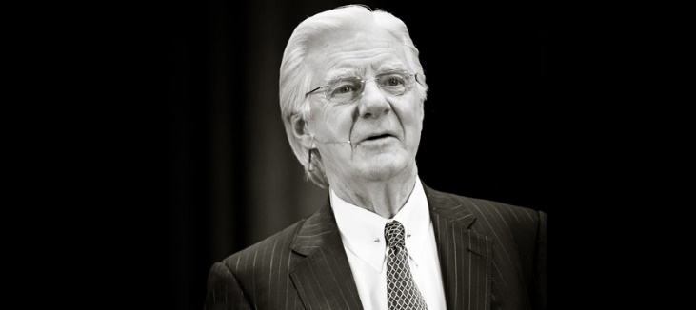

Meet
Bob Proctor
Sandy Gallagher
Let's Take A Closer Look At...
Let's Take A Closer Look At...

Slide 66

Client Success Stories

Slide 67
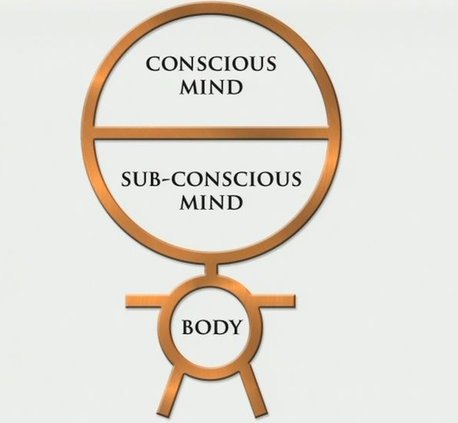
WHY DON’T OUR RESULTS CHANGE?
WE THINK ABOUT OUR CURRENT RESULTS
THOUGHTS
FEELINGS
Actions
Results!
VIBRATION

Slide 68

Can You Relate To These Three
Lifestyle Desires?
3. I would like to enjoy daily relationships
_{with other men and women who}
_{are upbeat, enthusiastic and}
_{creatively productive.}
2. I want to wake up every morning
enthused about how I am
going to spend my day.
1. I want to be free of
any financial concerns.

Slide 69
THINKING INTO FINANCIAL RESULTS
YOUR WANT
THINK ABOUT YOUR GOAL
GET EXCITED
Better
Results
Actions
VIBRATION

Slide 70


