Slide 1
Lesson Four – The Secret Genie

Slide 2
Worksheet Review
Lesson Three - Your Infinite Mind
You rewrote, in great detail, all of the NPAs you identified in the first exercise in Lesson Two.
You rewrote all of the NPAs you identified in the second exercise in Lesson Two.
Then you wrote a detailed description of the results that you do want.
You rewrote, in as much detail as possible, all of the PAs you identified to replace the NPAs.
Then you burned or shredded the two sheets of paper with the unwanted results and the NPAs.

Slide 3
Call Agenda
Introduce Lesson Four – The Secret Genie
Review Lesson Three / Worksheets
Watch the Lesson Four Video
Cover the Key Points
Worksheet Introduction – Lesson Four
Wrap Up

Slide 5
This is your mind!

Slide 7
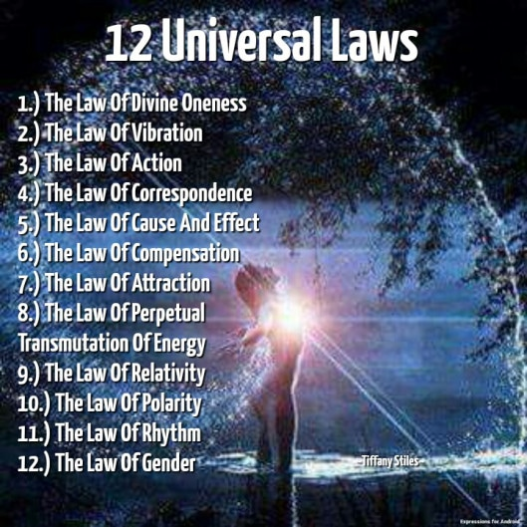

Slide 9
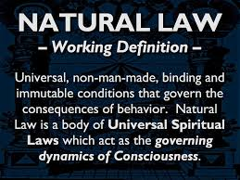

Slide 10
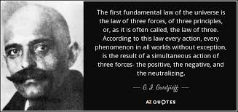

Slide 14
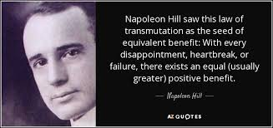

Slide 15
“Your world is a living expression of how you are using
and have used your mind.”
~ Earl Nightingale

Slide 16
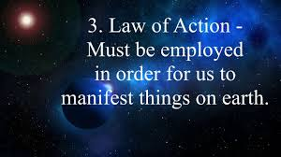

Slide 17
The Secret Genie
What You’ll Learn
How to gain control over the thoughts you think
How the Law of Attraction works to help you achieve any goal you want
A repeatable formula that can be used to change any result you are unhappy with

Slide 18
The Secret Genie
Conscious
Mind
Subconscious
Mind
Body

Slide 19
Key Points
If you objectively view another person’s behavior, you will understand what is going on in their mind.
Vibration is a natural law of the Universe. Everything vibrates…nothing rests. We literally live in an ocean of motion. Your body is a molecular structure in a very high speed of vibration.

Slide 20
The Stickperson
Conscious
Mind
Mind
Subconscious
Mind
Conscious
Mind
Subconscious
Mind
Body

Slide 21
Worksheet Introduction
Lesson Four: The Secret Genie
List six (1-2) habits that you will change:
What is a belief you have difficulty with that you would like to strengthen?
Think of a very close associate or friend. What behavioral patterns do they have that could be considered annoying?
If that person were doing this exercise about you, what do you think they would say?
What daily actions do you have that are habitual that ensure you are moving toward your goal?

Slide 22
Worksheet Introduction
Lesson Four: The Secret Genie
Begin by examining how you spend your days.
If a disappointing situation occurs, do you react or respond to that situation?
Do you have difficulty staying focused on a project?
Do you have an organized continuing education program?
What are your greatest strengths?
What are your greatest weaknesses?
Do you intend to eliminate your weaknesses? Which ones?

Slide 23
Universal Laws Allow You to

Slide 30
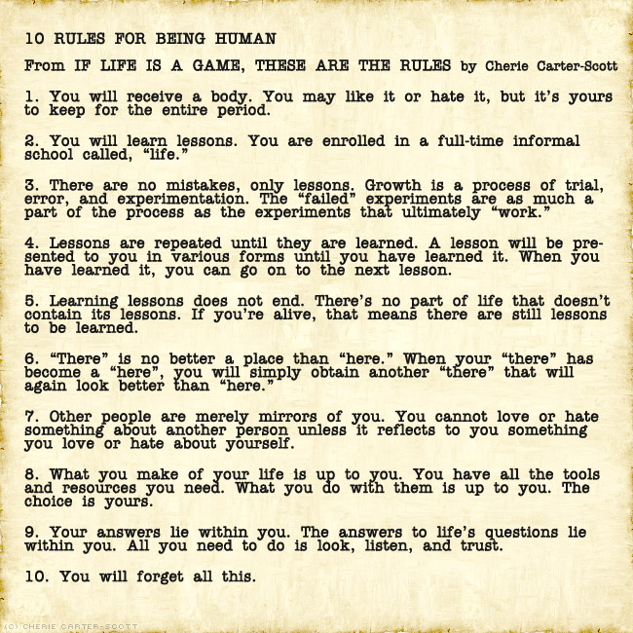
Pg. 61

