Slide 1
Lesson Three – Your Infinite Mind

Slide 4
Call Agenda
Introduce Lesson Three – Your Infinite Mind
Review Lesson Two Worksheets
Cover the Key Points
Worksheet Introduction – Lesson Three
Wrap Up

Slide 5
Review - Lesson Two: The Knowing/Doing Gap
Describe a situation where you are currently not getting the results you’d like.
Now describe the situation in the way you’d truly like it to be.
Highlight the actions in each scenario and divide them into two categories NPAs and PAs.
Write 6 action steps you can take right now to move towards turning your NPAs into PAs.

Slide 6
Worksheet Introduction
Lesson Three: Your Infinite Mind
Go back to the first exercise in Lesson 2 and rewrite the detailed description of the results you are getting that you do not want.
Go back to the second exercise in Lesson 2 and rewrite all of the Non-Productive Activities (NPAs) you identified in as much detail as possible.
Then Rewrite the detailed description of the results that you do want.
Rewrite, in as much detail as possible, all of the Productive Activities (PAs) you identified to replace the NPAs.
Take the two sheets of paper with the unwanted results and the Non-Productive Activities and shred them. As you are shredding the sheets of paper, mentally release them. Hold an image of yourself actively involved in the Productive Activities that you have selected to replace the Non-Productive Activities.

Slide 8
Your Infinite Mind -
Using Your Mind to Get The
Results You Want

Slide 11
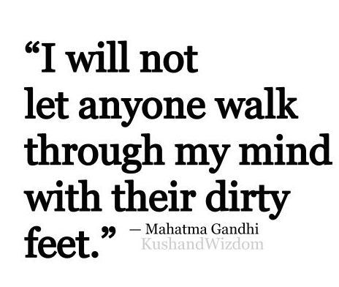

Slide 13
The Mind Is Your City On The Top of the Hill

Slide 15
You have dominion over mind…
This is where the Positive or Negatives Reside

Slide 16
Key Points
To establish new, improved, permanent results you must change your paradigm.
For a permanent improvement in results, the paradigm must be changed and to change paradigms you must change habits.
It’s a common error for a person to merely eliminate a negative habit thinking the results will improve. It has been established that if a negative habit is not consciously and deliberately replaced with a positive habit, another negative habit will automatically replace it.
To change our results, we should select one or two habits that require changing and immediately begin to move into action.

Slide 17
Focus on One or Two Paradigms

Slide 18
Be Aware of Fear

Slide 19
Be Aware of Negative Thoughts
Words Have Power
Listen to What You Say
Positive Words

Slide 23
READ STUDY
Daily
Next Two
Weeks

Slide 29
I, ___________________ (your name), am committed to taking the following action step this week _______________________________
(state the action step).
________________ ________
Signature Date

