Slide 1
Client Onboarding
Orientation

Slide 6
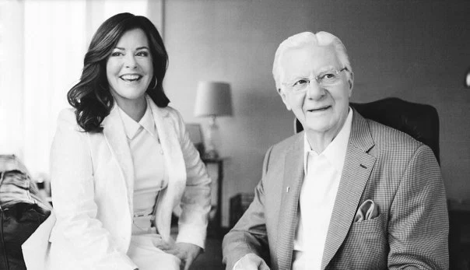

Slide 9
Why Repetition Is Necessary
When Changing Paradigms
This Is A THOUGHT FREQUENCY
Yellow Line Represents You Thinking About An Idea, Not Listening
PARADIGM
IDEA Hits Your Conscious Mind
Results
v
Red Line Above Represents You Listening To The Recording
White Line Above Represents The Sound Of A Recording Playing
Notes:
9
9

Slide 11
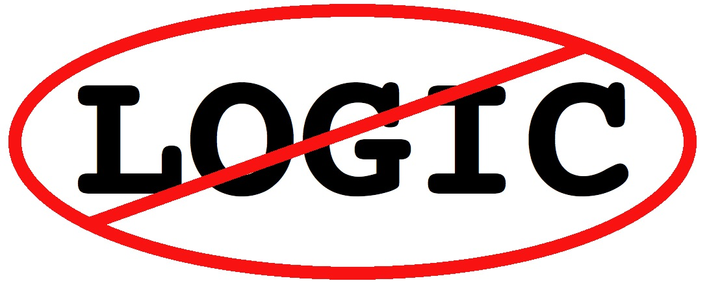

Slide 25
This Is The Access Info Lesson 1 – A Worthy Ideal
http://clients.proctorgallagherinstitute.com
Email: preview@thinkingintoresults.com
Password: preview

